Slide 1

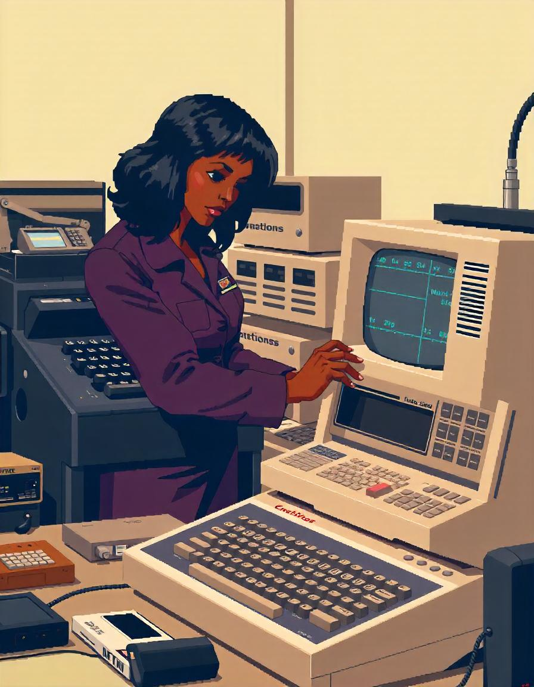
Short &
Sweet history
Of Computing
By: Exa

Slide 2
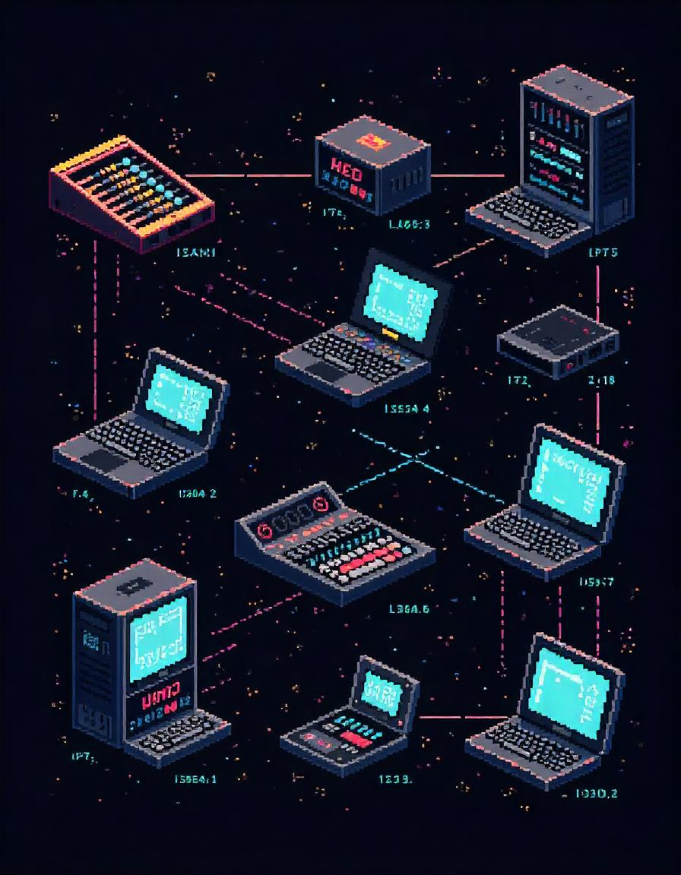
Header 1
The Past…
Notes:
>
>
>
>
>
Graphic stats
X X
X X
X X
X X

Slide 3
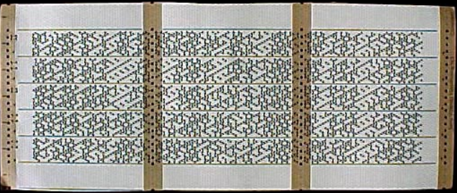
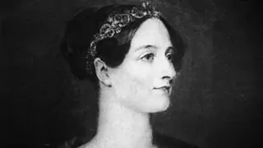
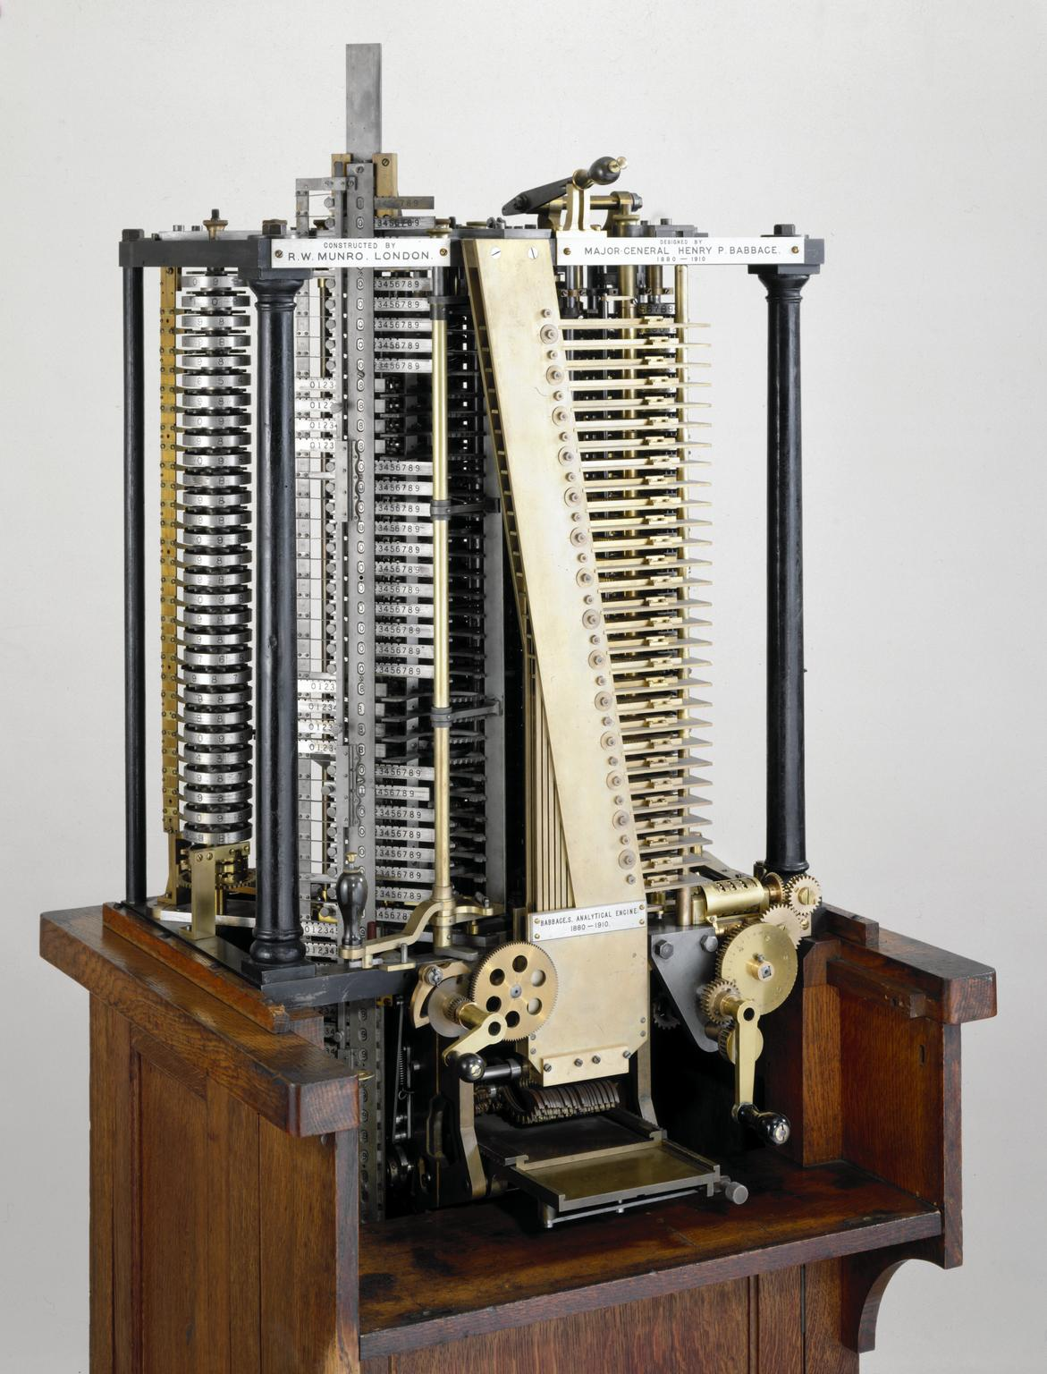
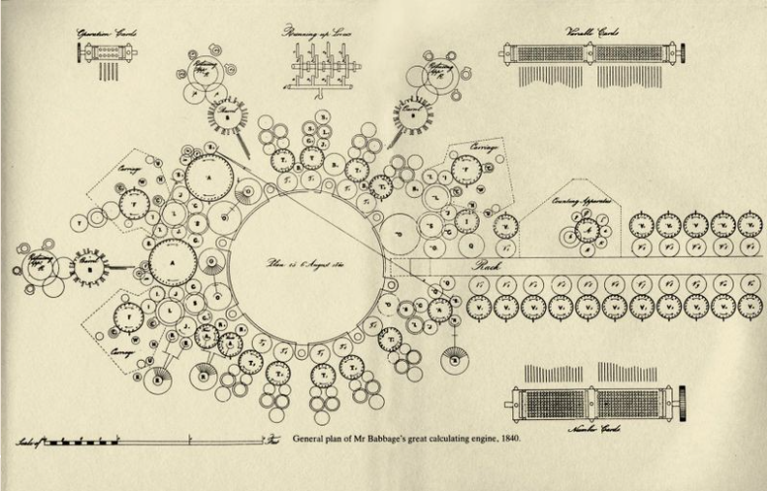
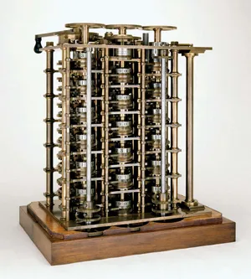
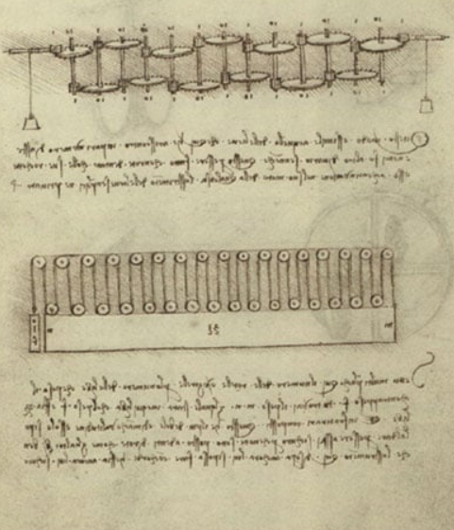
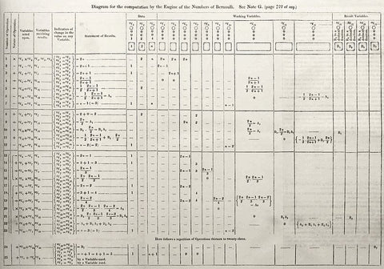
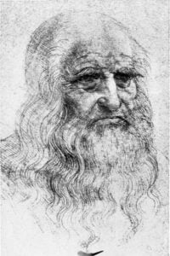
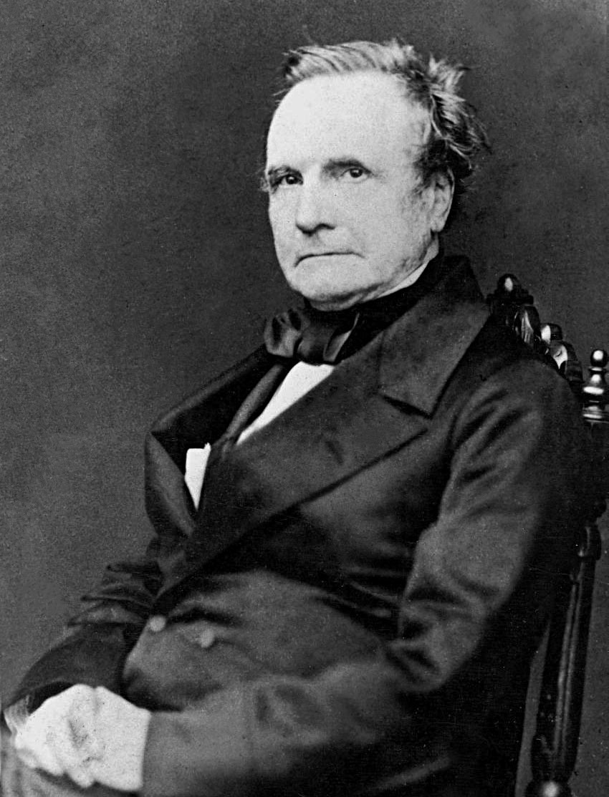
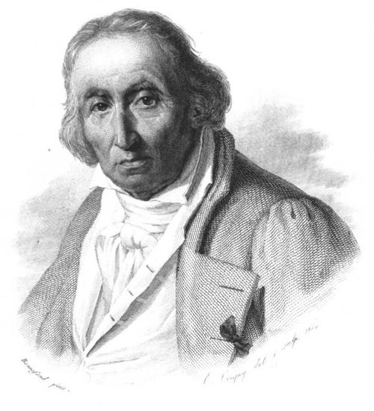
Leonardo da Vinci
It’s proposed that Da Vinci may have conceived the first models of a mechanical calculator in 1502 with mis manuscript of ‘Codex Madrid’; Doctor Roberto Guatelli was commissioned by IBM in 1968 to create a replica. Such a ‘Device of calculations’ was only able to commit operations of addition & subtractions.
Joseph Marie Jacquard
In 1804 Joseph patented the use of interchangeable punch cards for looms which dictated instructions on how to weave the fabric into delicate patterns acting like modern storage devices building upon Jacques de Vaucanson’s concept of the automatic loom.
Charles Babbage
Difference Engine: Uses the finite differences to calculate polynomial functions & mathematical tables. However, even with government funding (£17,500), the complexity couldn’t be fulfilled by the British technology especially in scale to the funding and simpler alternatives. Furthermore, due to limited functionality & fiscal prospects, the project was suspended in 1833 & finally disbanded in 1843.
The difference Engine No. 0 was built between 1820-1822 handled up-to 8 digits for calculations such as (x2 + x + 41 for 0 ≤ x ≤ 29) in 2.5 minutes.
The difference Engine No. 2 was built between 1846-1849 by the Science museum; it featured: printing features, capability to tabulate 31-digit numbers with 7th order differences.
The Analytical engine was a concept Babbage proposed in 1837 which proposed the use of: a CPU called ‘The mill’, expandable memory called ‘The store’, ‘The reader’ which took in inputs, ‘ The printer’ which displayed outputs. His use of punch cards expanded upon Jacquard’s patent and could calculate various arithmetic functions on 1,000 numbers with 50 digits each. Unfortunately, the funding was inadequate and remains as a practically untested concept.
Ada Lovelace
While translating Babbage's work on the analytical engine, Ada pioneered the possibility of its implementation beyond mathematical calculations, suggesting its potential in interpreting music notes, letters/symbols and perhaps images. Therefore, Ada included further instructions as well as corrections to Babbage's work upon its theoretical use, such would go onto be the first computational algorithm intended to calculate Bernoulli's numbers.

Slide 4
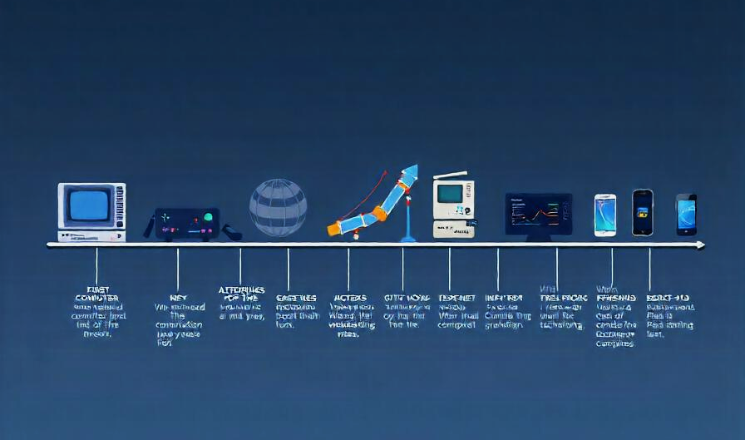
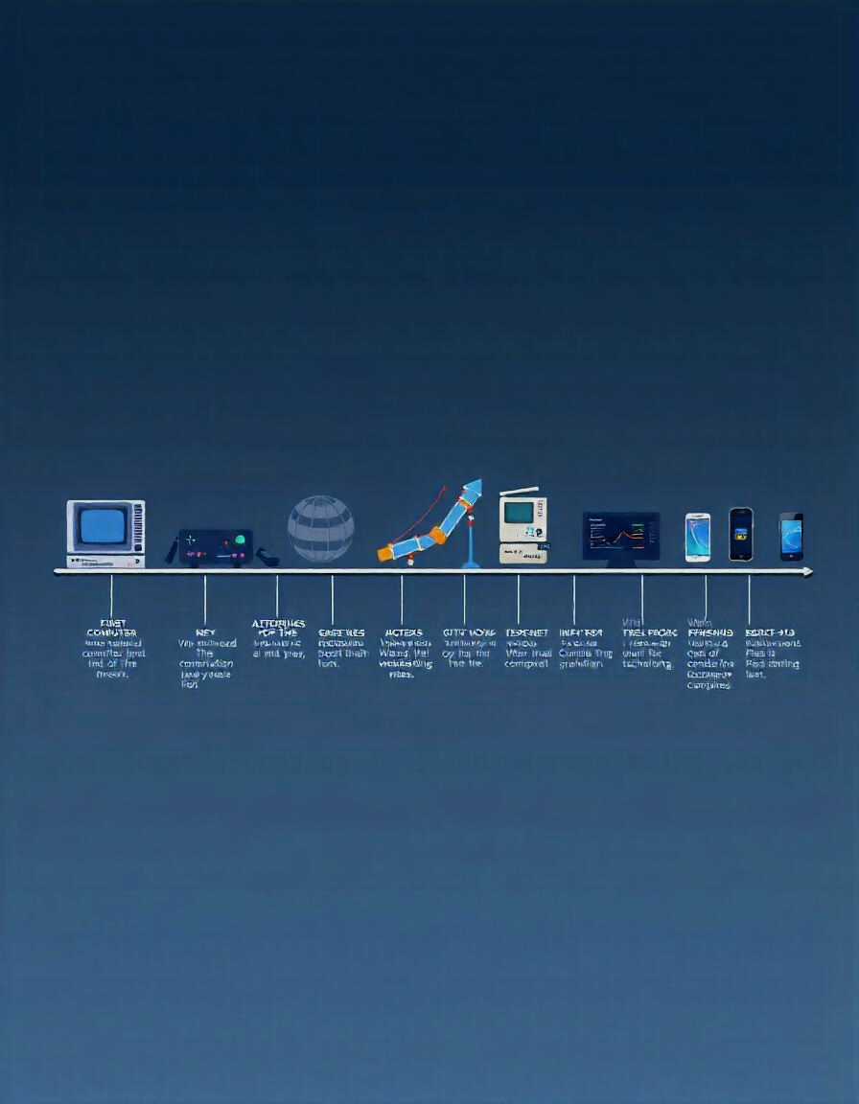
Radical innovators
WW2 garnered demand in decrypting the infamous ‘Enigma’ machine; young Alan Turing set about in using brute force using his Turing machine(1936) which later set foundations to moder computing due to his success. His conceptualisation of abstract des following Ada Lovelace, led his publication of "Computing Machinery and Intelligence“ describing AI & proposing a rudimentary test(Turing test(1949)) to determine its behaviour & ability to be distinguished while coining elements of Schrodinger's cat experiment such as uncertainty. His attempt in describing intellect via self-learning helped develop current ML & DL methods. Furthermore, in 1946 he designed the first ACE based of the theoretical Von Neuman architecture allowing both instructions & data storage in memory.

Slide 5
Radical innovators
Self taught George Boole introduced Boolean algebra through his book("The Mathematical Analysis of Logic" ) in 1846. Such radical shift towards a binary based system allowed innovation be less complex in overall design of system architecture. Its many benefactors such as : error detection, efficiency , etc embedded his ideology into modern systems with his next publication ("An Investigation of the Laws of Thought“) in 1854 vastly popularising use of logic gates. | WW2 garnered demand in decrypting the infamous ‘Enigma’ machine; young Alan Turing set about in using brute force using his Turing machine(1936) which later set foundations to moder computing due to his success. His conceptualisation of abstract des following Ada Lovelace, led his publication of "Computing Machinery and Intelligence“ describing AI & proposing a rudimentary test(Turing test(1949)) to determine its behaviour & ability to be distinguished while coining elements of Schrodinger's cat experiment such as uncertainty. His attempt in describing intellect via self-learning helped develop current ML & DL methods. Furthermore, in 1946 he designed the first ACE based of the theoretical Von Neuman architecture allowing both instructions & data storage in memory.
Self taught George Boole introduced Boolean algebra through his book("The Mathematical Analysis of Logic" ) in 1846. Such radical shift towards a binary based system allowed innovation be less complex in overall design of system architecture. Its many benefactors such as : error detection, efficiency , etc embedded his ideology into modern systems with his next publication ("An Investigation of the Laws of Thought“) in 1854 vastly popularising use of logic gates.

Slide 6

Titans…..Fight!

Slide 7
Harvard
Aiken
John
Von Neumann
John’s preposition of EDVAC for general purpose utility, evolved The ENIAC computer(developed by Eckert & Mauchly) to store data & instructions in their memory rather than required manual reconfiguration per task. Such a concept of self storage allowed programs to dynamically alter themselves during runtime. Additionally, the rise of EDVAC solidified the use of binary as a standard globally in contrast to the decimal system used previously.
The Von Neuman Architecture is comprised of a: CPU,ALU,CU,MAR,PC & L1-3 cache registers to run FDE cycles at a set rate. This is the backbone of most technology currently even with its bottleneck of latency between memory & processing due to their physical modulated separation distance.
Harvard Architecture uses separate memory spaces for instructions & data which theatrically means that it runs faster as they can be accessed sententiously by the CPU during the FDE cycle. Due to its structure, memory usage can be highly optimised making them suitable for embedded systems. Unfortunately, due to the complexity & code size limitations, processors containing the Harvard architecture can be costly which is why they are not mainstream.

Slide 8
References
https://history-computer.com/people/leonardo-da-vinci/
https://historyofinformation.com/detail.php?entryid=1409
https://www.freepik.com/
Taylor, Nick. (1992). Charles Babbage's Mini-Computer - Difference Engine No. 0. IMA Bulletin. 28. 112-114.
https://www.alamy.com/stock-photo/joseph-marie-jacquard.html?sortBy=relevant
https://www.bbc.co.uk/programmes/p030s5bx
https://www.britannica.com/technology/Difference-Engine
https://mimicrobots.com/pages/ada-lovelace-and-the-invention-of-code
https://collection.sciencemuseumgroup.org.uk/objects/co62246/henry-babbages-analytical-engine-mill-1910-analytical-engine-mills
https://en.wikipedia.org/wiki/Analytical_engine
https://blogs.bodleian.ox.ac.uk/adalovelace/2018/07/26/ada-lovelace-and-the-analytical-engine/
https://www.educalc.net/page/197481/
https://www.computerhistory.org/babbage/adalovelace/
https://www.linkedin.com/pulse/how-leonardo-da-vinci-inspired-todays-technology-yazdinian
https://www.scienceandindustrymuseum.org.uk/objects-and-stories/jacquard-loom
https://www.historyofinformation.com/detail.php?id=644
https://www.vaia.com/en-us/explanations/computer-science/computer-organisation-and-architecture/von-neumann-architecture/
https://www.geeksforgeeks.org/computer-organization-von-neumann-architecture/
https://www.geeksforgeeks.org/harvard-architecture/?ref=lbp

